Slide 1



ICS 590 | Special Topics in Deep Learning
Course Project
Artificial Intelligence in Ophthalmology: Fundus Based Multi-Classification Deep Learning for Glaucoma Detection
PRESENTER: ZEINA ALABIDO
COURSE SUPERVISOR: PROF. MUZAMMIL BEHZAD
Day, Month, 2025
1

Slide 2
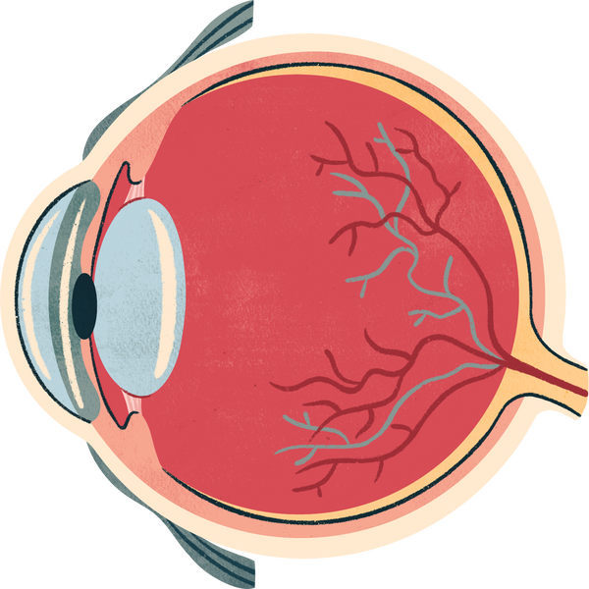
ICS 590 | Special Topics in Deep Learning
Course Project
Presentation Outline
Introduction
Problem Statement
Solution Approach and Methodology
Results and Evaluation
Conclusion
Future Work
2

Slide 3
ICS 590 | Special Topics in Deep Learning
Course Project
Introduction
Glaucoma is one of the well-known Retinal diseases that happen due to factors that lead to irreversible sight loss. It occurs when the fluids of the eye do not drain correctly, consequently, that leads to eyeball pressure. There is an optic nerve connected in between their eye and the brain, which will be affected by this pressure. Approximately 3.6 million people might be affected with blindness because of glaucoma.
3

Slide 4
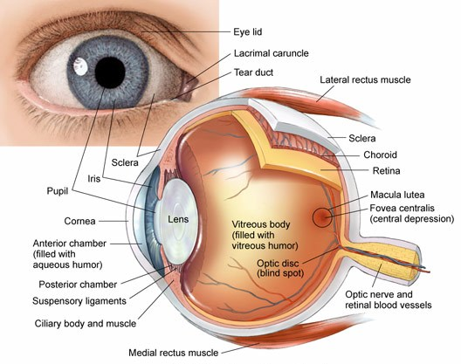
ICS 590 | Special Topics in Deep Learning
Course Project
4

Slide 5
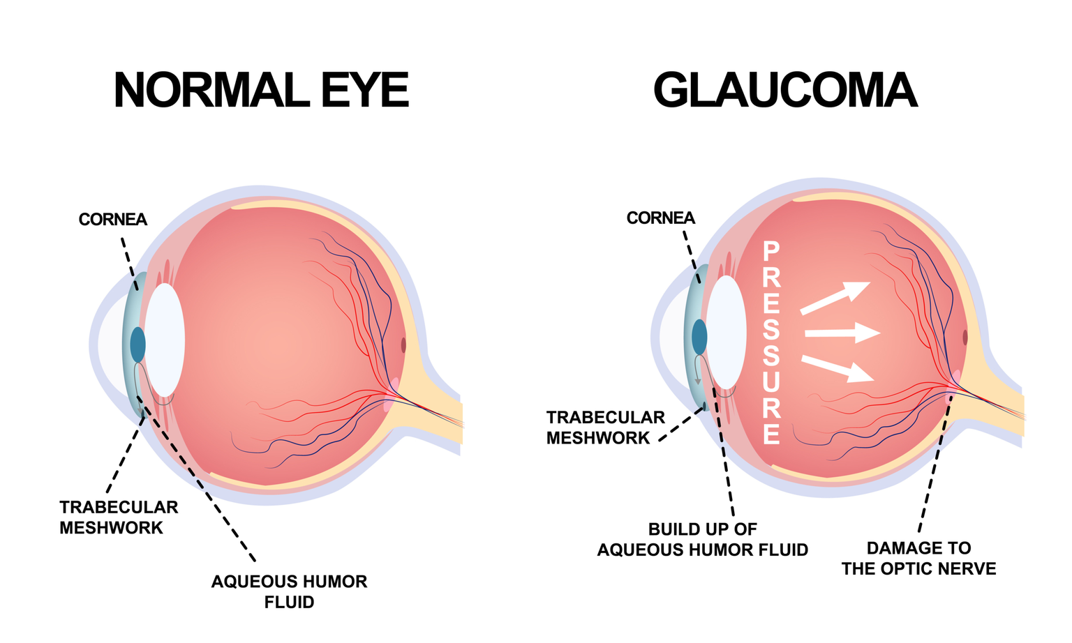
ICS 590 | Special Topics in Deep Learning
Course Project
5

Slide 6

ICS 590 | Special Topics in Deep Learning
Course Project
Problem Statement
Weak AI Models for predicting Multi-classification types of Glaucoma
Datasets of Fundus
Image are very small
Patients Privacy
6

Slide 7
ICS 590 | Special Topics in Deep Learning
Course Project
Solution Approach and Methodology
Dataset Collection and Augmentation
Models Selection
Optimization
Performance Evaluation
Results
7

Slide 8
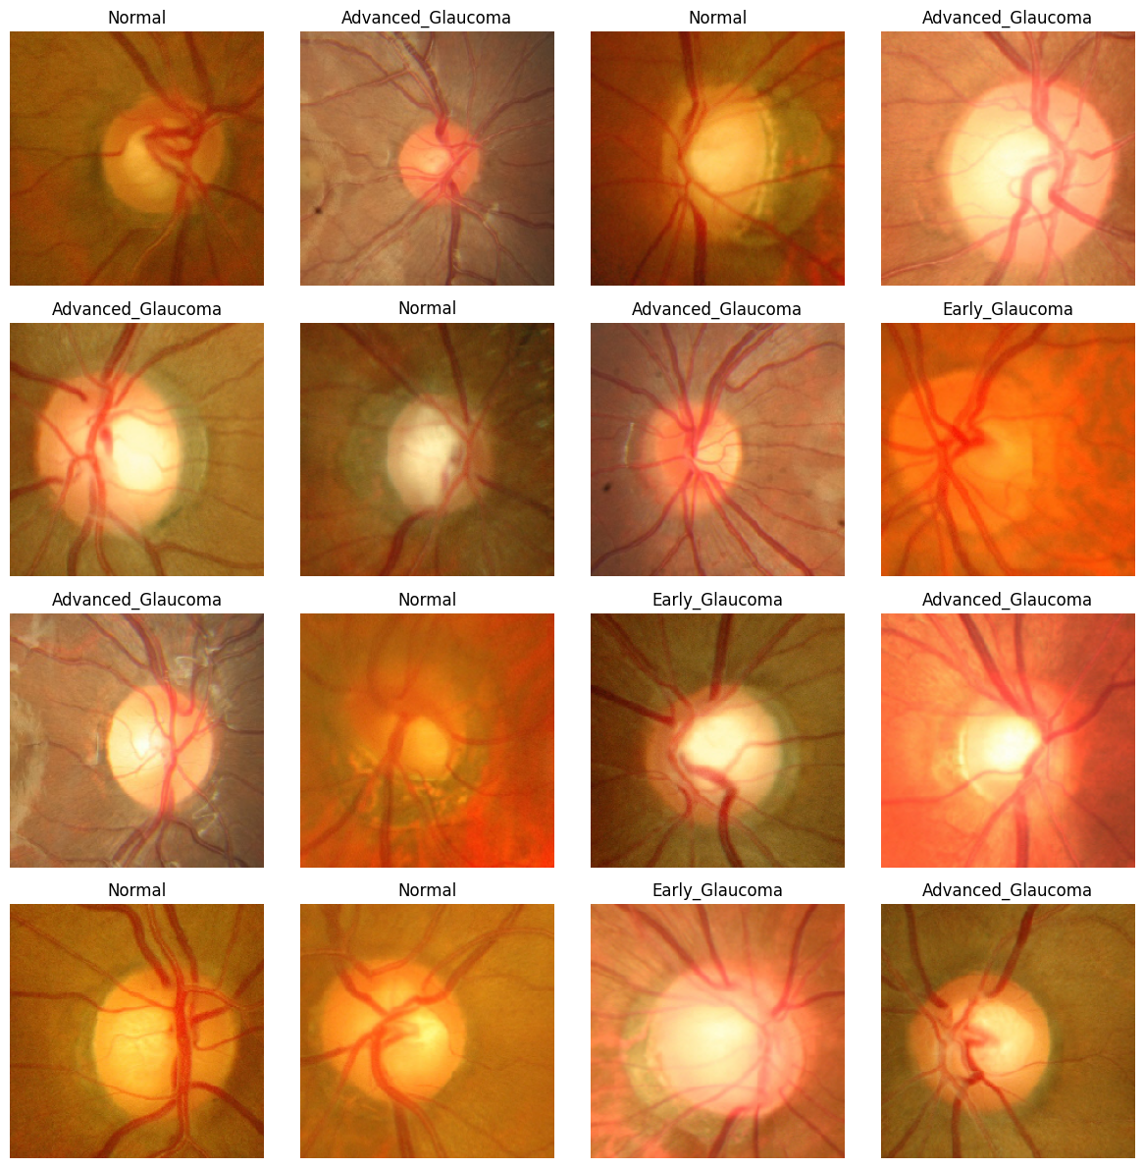
ICS 590 | Special Topics in Deep Learning
Course Project
Dataset Collection and Augmentation
8

Slide 9
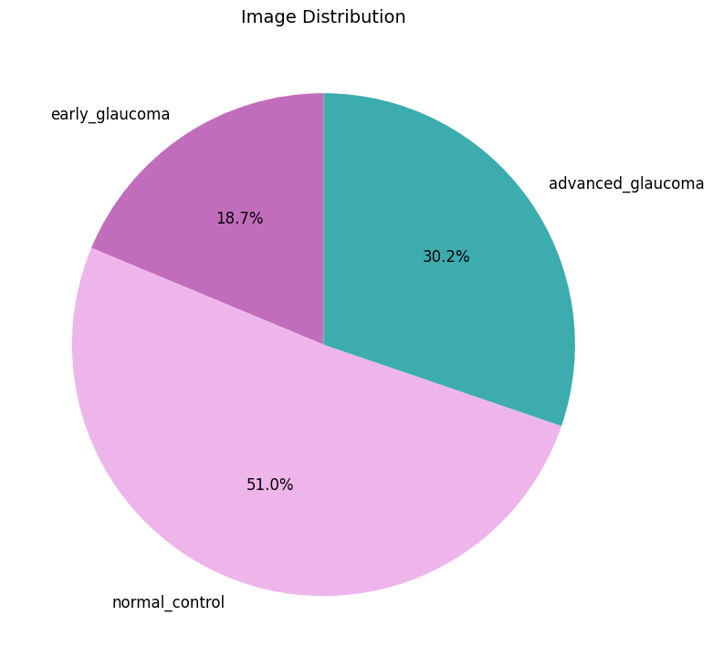
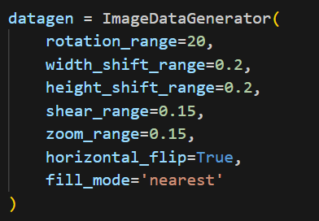
ICS 590 | Special Topics in Deep Learning
Course Project
Dataset Collection and Augmentation
1544 Image
9

Slide 10
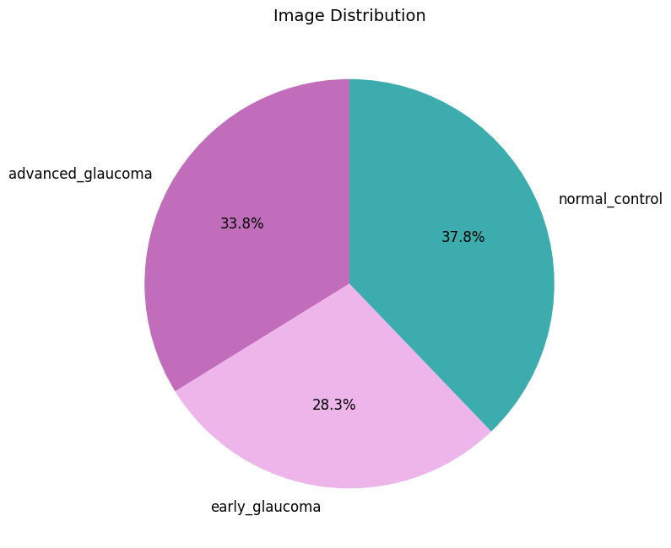
ICS 590 | Special Topics in Deep Learning
Course Project
Dataset Collection and Augmentation
After Data Augmentation:
28011 Image
Label Encoding has been applied for the classes:
'advanced_glaucoma' = 2 'early_glaucoma' = 1 'normal_control' = 0
Data Splitting into:
Train 80% = 22410 sample
Test 20% = 5601 sample
10

Slide 11
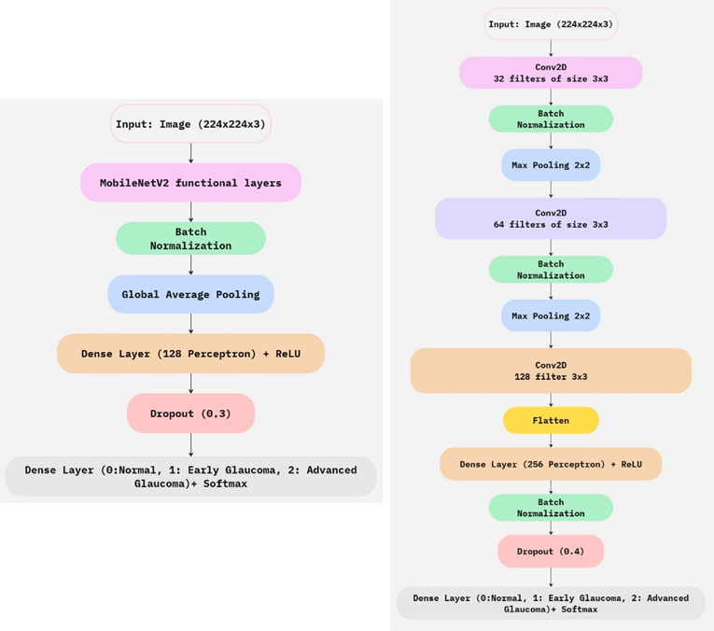
ICS 590 | Special Topics in Deep Learning
Course Project
Neural Networks Selection
Custom-CNN
Custom-MobileNetV2
Max Pooling (2,2)
Batch Normalization
Flatten Layer
ReLU Activation Function
SoftMax Activation Function
Dropout
11

Slide 12
ICS 590 | Special Topics in Deep Learning
Course Project
Adam Optimizer: is an optimization technique used to adjust the learning rate during the training , it combines between the advantages of Root Mean Square Propagation (RMSProp), and the momentum.
Categorical Cross Entropy Loss Function: categorical cross entropy loss function is used to calculate the loss by the models they are classifying, and it is used when we have more than two classes to classify (multi-classification problems).
Accuracy: has been used as a performance metric, which is a measure of how often the model’s predictions are correct, and it is measured by dividing the number of correct predictions, by the total number of predictions. for both CNN and MobileNetV2.
12

Slide 13
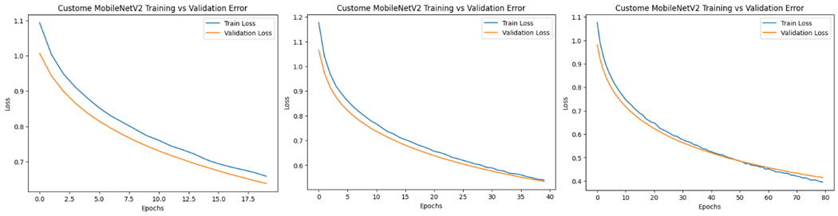
ICS 590 | Special Topics in Deep Learning
Course Project
Results and Discussion
MobileNetV2 Performance on 20, 40, and 80 epochs
13

Slide 14
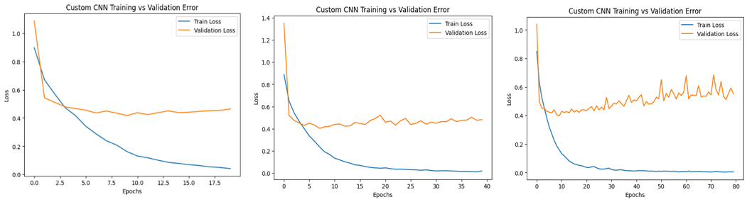
ICS 590 | Special Topics in Deep Learning
Course Project
Results and Discussion
CNN Performance on 20, 40, and 80 epochs
14

Slide 15
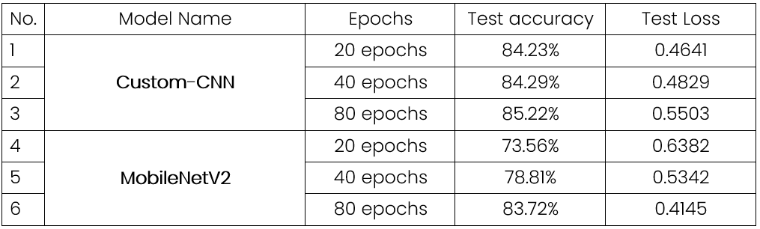
ICS 590 | Special Topics in Deep Learning
Course Project
Results and Discussion
Overall results for the accuracies, training loss, and testing loss for both CNN and MobileNetV2:
15

Slide 16
Thank You
FOR YOUR ATTENTION
ANY QUESTIONS?

